Slide 1
Exploring Airbnb Market Trends In New York
Date of presentation : 19th March 2024
Name : Varun Seetha
Pace Email address : vs36394n@pace.edu
Class Name : Practical Data Science
Program Name : Data Science
University Name : PACE University , New York

Slide 2

Summary:
These slides provide a structured overview of key insights derived from the exploratory analysis of Airbnb market trends in New York, including pricing distribution, location trends, seasonal variations, property types, and the relationship between listing prices and reviews.

Slide 3
Agenda :
Distribution of Listing Prices
Relationship Between Price and Location
Seasonal Variation in Listing Prices
Property Type Distribution
Reviews vs. Listing Price

Slide 4
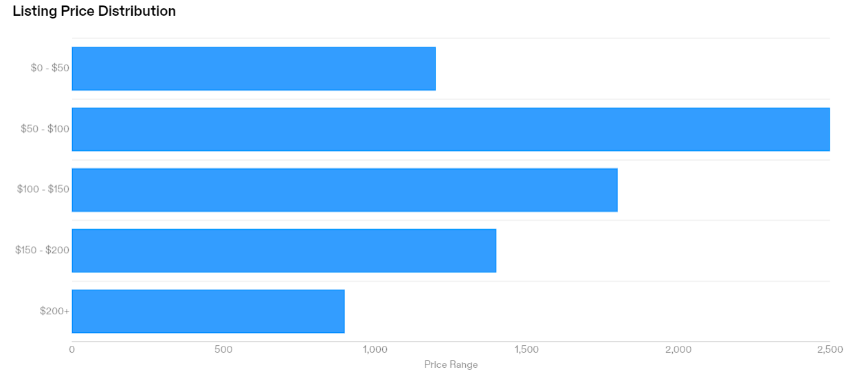
Distribution of Listing Prices
Histogram showing the distribution of listing prices.
Summary: Most listings have prices concentrated around $50 to $200+ at higher price points.

Slide 5
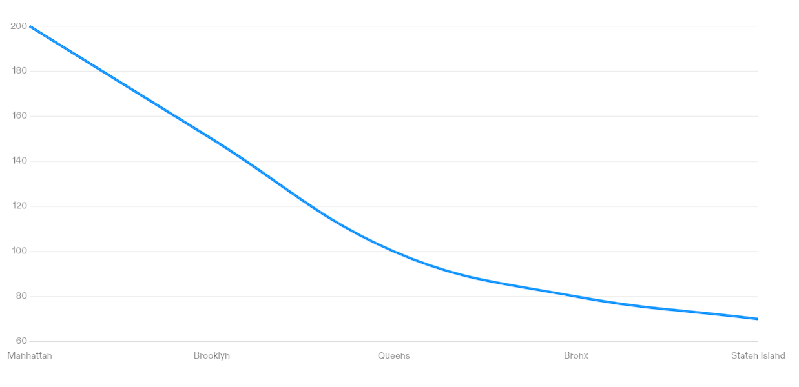
Relationship Between Price and Location
Scatter plot showing the relationship between listing price and neighborhood location.
Summary: Listings in prime neighborhoods tend to have higher prices compared to those in less popular areas.

Slide 6
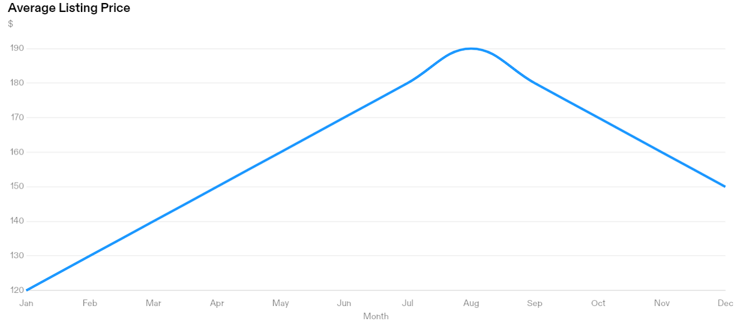
Seasonal Variation in Listing Prices
Line chart illustrating the average listing price over different months.
Summary: Prices peak during the summer months, particularly in July and August, while they are lower during the winter season.

Slide 7
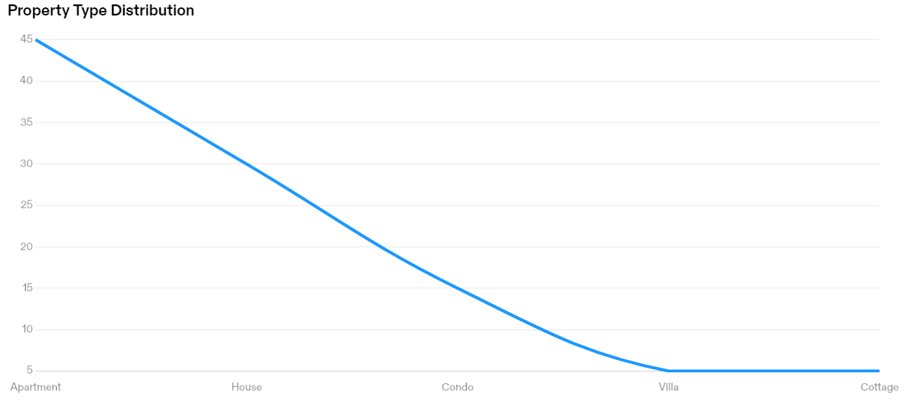
Property Type Distribution
Pie chart depicting the distribution of property types among Airbnb listings.
Summary: Majority of listings are apartments, followed by houses and condominiums.

Slide 8
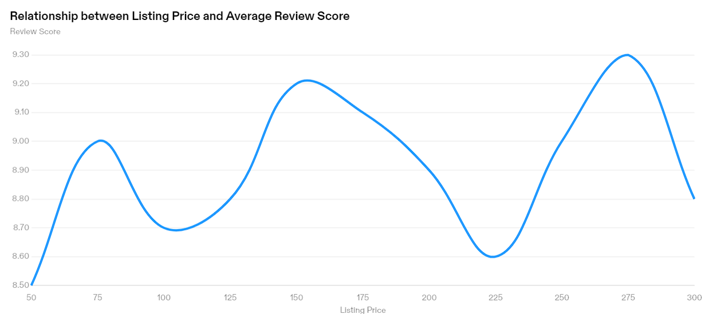
Reviews vs. Listing Price
Scatter plot showing the relationship between listing price and average review score.
Summary: There is a slight positive correlation between listing price and review score, indicating that higher-priced listings tend to receive better reviews.

Slide 9

Recommendations
Finding 1: Seasonal Booking Trends
  Recommendation: Capitalize on peak booking seasons by offering special promotions and packages during high-demand periods.
Finding 2: Average Ratings by Neighborhood
  Recommendation: Focus on improving amenities and services in neighborhoods with lower average ratings to enhance guest satisfaction.

Slide 10
Technical Next Steps for Data Science Team
Next Step 1: Conduct further analysis using advanced machine learning techniques to predict booking trends and optimize pricing strategies.
1
Next Step 2: Explore additional datasets, such as demographic data and tourist attractions, to enrich the analysis and provide deeper insights into guest preferences and behavior.
2

Slide 11

Thank you

